Slide 1

Security and Privacy: Computers and the Internet

Slide 2
Objectives
Explain the different types of computer crime and the difficulties of discovery and prosecution. (1,5,9 & 13)
Describe the aspects of securing corporate data, including software and data security, disaster recovery plans, and security legislation. (2, 6, & 10)
Describe in general terms how viruses work, the damage they can cause, and procedures used to prevent this damage. (3,7, 11 & 14)
Explain the threats to personal privacy posed by computers and the Internet. Describe actions you can take to maximize your privacy. (4, 8, & 12)

Slide 3
Contents
Computer Crime
Security
Disaster Recovery
Backup
Pests
Privacy
Junk e-mail
Protecting Children

Slide 4
Computer Crime
Stealing and using or selling of data:
Company data
Personal information in company files

Slide 5
Computer Crime
Employees and individuals need to recognize the possible danger from computer systems and protect their assets.

Slide 6
Computer Crime
Security and Privacy
Data communications capabilities provides new challenges
Keep data secure
Destruction
Accidental damage
Theft
Espionage
Keep data private
Salaries
Medical information
Social security numbers
Bank balances

Slide 7
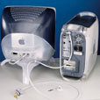
Data, not equipment (cont)
Computer Crime
Ways to secure data
Locked servers
Removable hard drives that are locked when not in use
Hard disk drives requiring special tools for detachment
Physical cages around computers that prohibit access
Passwording files

Slide 8
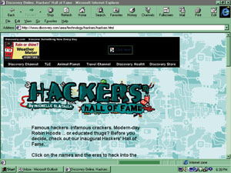
Computer Crime
Supplies for the Hacker
  PC
  Communications network
Why hack?
  Harass
  Show-off
  Gain access to computer services without paying
  Obtain information to sell
Hackers are individuals who attempt to gain access to computer systems illegally

Slide 9
White-hat hackers
Computer Crime
Hackers for Hire
Computer professionals hired to illicitly gain entry into a system
  Reveal weak points
  Protect the points
  May not alert its own employees of the testing
Intrusion tester
White hat hackers

Slide 10
Computer Crime
What Systems Have Been Invaded?
Corporate networks
  Over half largest corporations were invaded
  Competitors?
Government networks
  Dept of Defense attacked more than 200,000 times per year
  Computer attack abilities of other nations?
Web sites

Slide 11
Computer Crime
How Can Systems be Easily Compromised?
Social engineering
  Con artist – persuade others to give away their passwords over the phone
Electronic pickpockets
  Use computers to transfer or change assets to their advantage

Slide 12
Computer Crime
Frequently Reported Crimes
Credit-card fraud
  Numbers captured and used fraudulently
Data communications fraud
  Piggyback on someone else’s network
  Office network for personal purposes
  Computer-directed diversion of funds
Unauthorized access to computer files
  Accessing confidential employee records
  Theft of trade secrets and product pricing
Unlawful copying of copyrighted software
  Casual sharing of copyrighted software
  Assembly-line copying

Slide 13
Computer Crimes
Bomb
  Program to trigger damage
  Scheduled to run at a later date
  May be found in software for general public, especially shareware
Data diddling
  Changing data before or as it enters the system
Denial of service attack (DOS)
  Hackers bombard a site with more request for service than it can possible handle
  Prevents legitimate users from accessing the site
  Appearance of requests coming from many different sites simultaneously

Slide 14
Computer Crimes
Piggybacking
  Original user does not sign off properly
  Intruder gains accesses to files via the original user id
Scavenging
  Search garbage and recycling bins for personal information

Slide 15
Computer Crimes
Trapdoor
  Illicit program left within a completed legitimate program
  Permits unauthorized and unknown entry to the program
Trojan horse
  Illegal instructions placed inside a legitimate program
  Program does something useful and destructive at the same time
Zapping
  Software to bypass security systems

Slide 16
Computer Crimes
Discovery
  Difficult
  Accidental
  85% of computer crimes are never reported
Prosecution
  Legal representatives lack technical knowledge to understand the crime

Slide 17
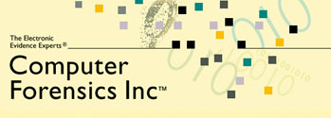
Computer Crime
Discovery and Prosecution
Computer Forensics
Uncovering computer-stored information suitable for legal use

Slide 18
Security
System of safeguards designed to protect a computer system and data from deliberate or accidental damage
Natural disasters
Fire
Accidents
Vandalism
Theft
Theft or destruction of data
Industrial espionage
Hackers

Slide 19
Security
Identification and Access
Provide access to authorized individuals only
Uses one of more of the following systems
  What you have
  What you know
  What you do
  What you are

Slide 20
Security
Identification and Access
What You Have
Key
Badge
Token
Plastic card – magnetized strip
Active badge – signals wearer’s location using infrared signals

Slide 21
Security
Identification and Access
What You Know
Password
Identification number
Combination

Slide 22
Security
Identification and Access
What You Do
Verify signature – software verifies scanned and online signatures

Slide 23
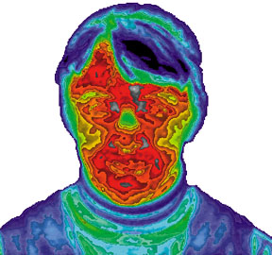
Security
Identification and Access
What You Are
Biometrics – science of measuring individual body characteristics
Fingerprints
Voice pattern
Retina of the eye
Entire face

Slide 24
Security
Identification and Access
Internal controls
  Transaction log
Auditor checks
  Who has accessed data during periods when that data is not usually used?
  Off-the-shelf software to access the validity and accuracy of the system’s operations and output

Slide 25
Security
Identification and Access
Secured waste
  Shredders
  Locked trash barrels
Applicant screening
  Verify the facts on a resume
  Background checks
Built-in software protection
  Record unauthorized access attempts
  User profile

Slide 26
Security
Software Security
Ownership
Company if programmer is employee
Contractual agreement if the programmer is not an employee
Software can be copyrighted

Slide 27
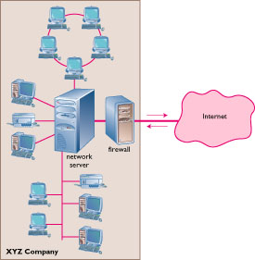
Security
The Internet
Firewall
  Dedicated computer that governs interaction between internal network and the Internet
Encryption
  Data Encryption Standard (DES)

Slide 28
Security
Personal Computers
Physical security with locks and cables
Surge protector
Uninterruptible power supply (UPS)
Backup files regularly and systematically

Slide 29
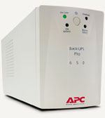
Disaster Recovery
Hardware loss
Can be replaced
Temporarily diminished processing ability
Software loss
Industry standard – make backups of program files

Slide 30
Disaster Recovery
Data loss
Reassemble records
  Customer information
  Accounting data
  Design information
Major costs and time

Slide 31
Disaster Recovery Plan
Restoring computer processing operations and data files if operations are halted or files are damaged by major destruction

Slide 32
Disaster Recovery Plan
Approaches
Manual services temporarily
Purchase time from a service bureau
Mutual aid pack
  Two or more companies will lend each other computer power
  Problem if regional disaster

Slide 33
Disaster Recovery Plan
Approaches
Consortium
  Joint venture
  Complete computer system
  Routinely tested
  Used only if disaster
  Sites
    Hot site – fully equipped and environmentally controlled computer center
    Cold site – environmentally suitable empty shell

Slide 34
Disaster Recovery Plan
Advance Arrangements
Everything except hardware safely stored in geographically distant locations
  Program and data files
  Program listings
  Program and operating systems documentation
  Hardware inventory lists
  Output forms
  Copy of the disaster plan manual

Slide 35
Disaster Recovery Plan
Includes
Priorities for programs
Plans for notifying employees
List of needed equipment and where it is located
Alternative computing facilities
Procedures for handling input and output data
Emergency Drills

Slide 36
Backup
Why Backup?
“If you are not backing up your files regularly, you deserve to lose them.”
Average user experiences loss once a year

Slide 37
Backup
What Can Cause Data Loss?
Incorrect software use
Input data incorrectly
Software may harm data
Hard disk malfunctions
Accidentally delete files
Virus infection

Slide 38
Backup
Methods
Full backup
Differential backup
Incremental backup
Media
Diskette
Tape
Zip disk
CD-R / CR-RW
DVD-RAM
Mirrored hard drive

Slide 39
Pests
Invade the computer system and cause something unexpected to occur
May interfere with function of PC

Slide 40
Worms
Rare
Transfers over a network
Plants as a separate file on the target’s computer

Slide 41
Viruses
Illicit instructions that pass themselves on to other programs
  Benign
  Damaging to computer
Digital vandalism

Slide 42
Viruses
Vaccine or antivirus
Stops the spread of and eradicates the virus
Install software
Download signature files regularly

Slide 43
Viruses
Retrovirus
  Fights the vaccine and may delete the antivirus software
Costs
  Billions of dollars a year
  Aggravation to individual users

Slide 44
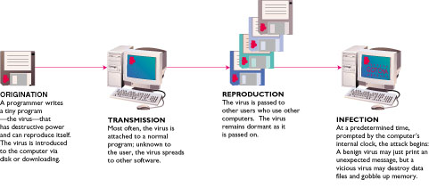
Virus Transmission
Networks
Diskettes

Slide 45
Virus
Getting Infected
Executing the virus program
Booting from a diskette containing an infected boot sector including accidentally leaving a “non-system disk” in the floppy drive
Downloading an infected file and executing it
Opening an infected e-mail attachment
By viewing e-mail in some versions of Microsoft Outlook

Slide 46
Virus
Precautions
Be wary of free software from the Internet or friends
Only install programs from diskettes in sealed packages
Use virus-scanning software to check any file or document before loading it onto your hard disk

Slide 47
Privacy
Where is my data?
How is it used?
Who sees it?
Is anything private anymore?
Everything about you is in at least one computer file

Slide 48
Privacy
How Did They Get My Data?
Loans
Charge accounts
Orders via mail
Magazine subscriptions
Tax forms
Applications for schools, jobs, clubs
Insurance claim
Hospital stay
Sending checks
Fund-raisers
Advertisers
Warranties
Military draft registration
Court petition

Slide 49
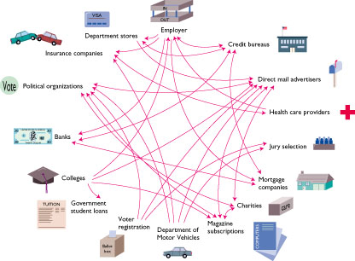
Privacy
How Did They Get My Data?

Slide 50
Privacy
Your Boss is Spying on You!
Monitoring software
  Screens
  E-mail
  Keystrokes per minute
  Length of breaks
  What computer files are used and for how long
Privacy groups want legislation requiring employers to alert employees that they are being monitored.

Slide 51
Privacy
Monitoring by Web Sites
Records:
City
Site you just left
Everything you do while on the site
Hardware and software you use
Click stream
  Series of clicks that link from site to site
  History of what the user chooses to view

Slide 52
Privacy
Monitoring by Web Sites
Cookie
Stores information about you
Located on your hard drive
Beneficial uses
  Viewing preferences
  Online shopping
  Secure sites retain password in cookie
Controversial use
  Tracking surfing habits for advertisers
Can set browser to refuse cookies or warn before storing
Software available to manage cookies

Slide 53

Junk e-mail
Cheaper than snail mail
Spamming
  Sends e-mail messages to “everyone”
  Abandons the originating site

Slide 54
Junk e-mail
Help eliminate junk e-mail
  Do not complete a member profile with online service
  Do not fill in registration forms unless the purveyor promises not to sell or exchange your information
  Never respond to spamming
Use filter software
States are beginning to provide laws banning unsolicited junk e-mail

Slide 55
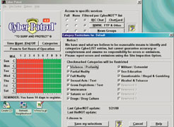
Protecting Children
Blocking software – high-tech chaperone
Examine browser history to see what sites are visited
Locate computer in a semipublic, high-traffic location of your home

Slide 56
Protecting Children
Laws
Communications Decency Act – 1996
Children’s Online Privacy Protection Act (COPPA) – 2000

Slide 57
Assignment
Explain the different types of computer crime and the difficulties of discovery and prosecution. (1,5,9 & 13)
Describe the aspects of securing corporate data, including software and data security, disaster recovery plans, and security legislation. (2, 6, & 10)
Describe in general terms how viruses work, the damage they can cause, and procedures used to prevent this damage. (3,7, 11 & 14)
Explain the threats to personal privacy posed by computers and the Internet. Describe actions you can take to maximize your privacy. (4, 8, & 12)

